Slide 1
Restoring a database in a SQL Server running into Docker

Slide 2
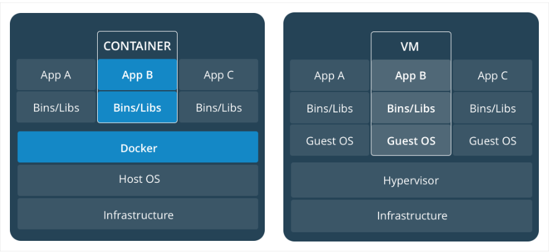
Docker, Container VS VM
Notes:
A Docker container image is a lightweight, standalone, executable package of software that includes everything needed to run an application: code, runtime

Slide 3
SQL Server in a Container
OS - Linux
SQL Server 2019 (Instance)
AdventureWorksLT2019
sa

Slide 4
Download & Install
Docker Desktop for Windows: https://hub.docker.com/editions/community/docker-ce-desktop-windows ***Windows 10 Pro/Enterprise 64-bit
SSMS - SQL Server Management Studio https://docs.microsoft.com/en-us/sql/ssms/download-sql-server-management-studio-ssms?view=sql-server-ver15
Download Demo Database - https://docs.microsoft.com/en-us/sql/samples/adventureworks-install-configure?view=sql-server-ver15&tabs=ssms
Window 10 Pro Preview - https://www.microsoft.com/en-us/software-download/windowsinsiderpreviewadvanced

Slide 5
Docker command
Install SQL Server 2019 docker command: docker run -e 'ACCEPT_EULA=Y' -e 'SA_PASSWORD=yourStrong(!)Password' -p 1433:1433 -d mcr.microsoft.com/mssql/server:2019-latest
Other commands: docker ps -a docker inspect b5fa6be28fe9 docker exec -u root -it bold_dubinsky bash mkdir /home/bkp ls /home/bkp docker cp C:\Users\xiaod\Downloads\SQLDBRestore\AdventureWorksLT2019.bak b5fa6be28fe9:/home/bkp
Notes:
docker run – Runs a command in a new container.
docker start – Starts one or more stopped containers
docker stop – Stops one or more running containers
docker build – Builds an image form a Docker file
docker pull – Pulls an image or a repository from a registry
docker push – Pushes an image or a repository to a registry
docker export – Exports a container’s filesystem as a tar archive
docker exec – Runs a command in a run-time container
docker search – Searches the Docker Hub for images
docker attach – Attaches to a running container
docker commit – Creates a new image from a container’s changes

Slide 6
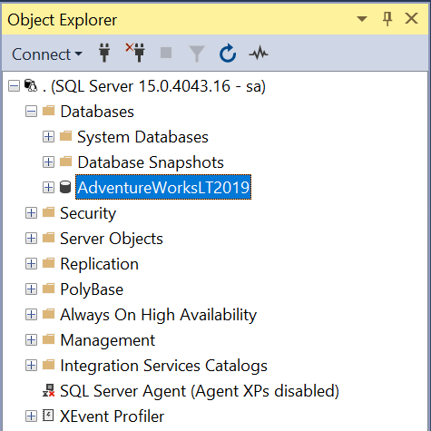
Database Restore Script
USE [master]
RESTORE DATABASE [AdventureWorksLT2019]
FROM DISK = N'/home/bkp/AdventureWorksLT2019.bak' WITH FILE = 1,
MOVE N'AdventureWorksLT2012_Data' TO N'/var/opt/mssql/data/AdventureWorksLT2012.mdf',
MOVE N'AdventureWorksLT2012_Log' TO N'/var/opt/mssql/data/AdventureWorksLT2012_log.ldf',
NOUNLOAD, STATS = 5
GO

Slide 7
Thanks for watching!
Please leave a comment if you have any questions!
If you like this video, please hit the below LIKE button and Subscribe it..

